Slide 1
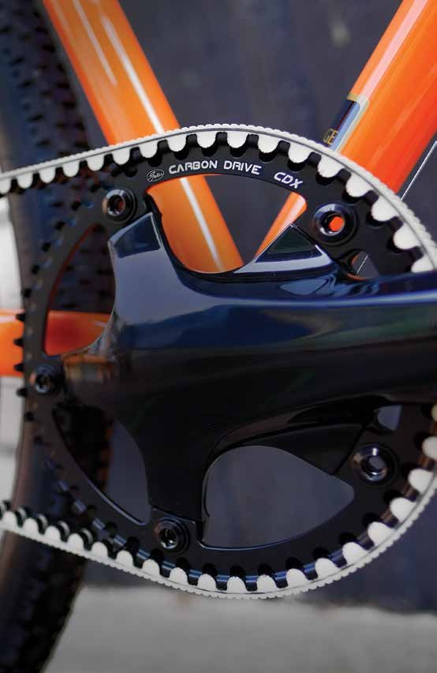

OWNER’S MANUAL
CLE AN
Q UIE T LIGHT STRONG

Slide 2

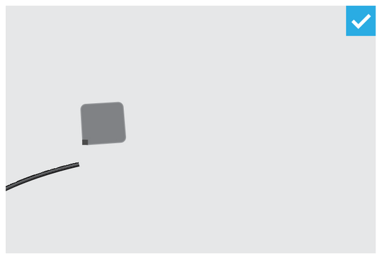
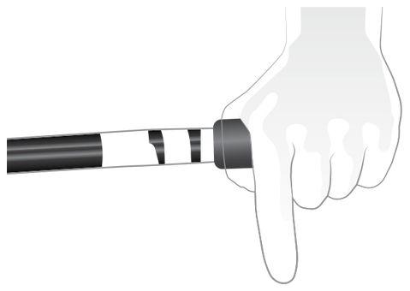






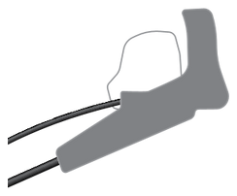




















OWNER’S MANUAL
GATES CARBON DRIVE
2
WARNING
Read this entire manual before using, replacing, or installing the Gates Carbon Drive belt. Improper installation, adjustment, alteration, service, or maintenance can result in property damage and serious bodily injury, including death. Refer to this manual for assistance or consult with a cycling professional for further information.
Gates requires a hand brake as the primary braking system.

Slide 3
GENERAL SAFETY
3
HANDLING THE BELT
Do not crimp, twist, backbend, invert, bundle or zip tie the belt. Do not use the
belt as a strap wrench or chainwhip. Do not roll on or pry on the belt.
See page 4.
Gates requires a hand brake as the primary braking system.
BELT TENSION AND DRIVE ALIGNMENT
Proper tension and drive alignment is key to optimal performance.
■
Lack of belt tension can lead to “skipping”. Too much tension can damage
other components and increase the wear of your Carbon Drive System.
Signs of a misaligned drive include, but are not limited to, noise,
premature belt or sprocket wear, belt walk-off. Detailed information
and schematics can be found in our Technical Manual located at
www.gatescarbondrive.com/tech/resources. You can also contact
us directly via email at: CarbonDrive@Gates.com.
■
CARE FOR YOUR CARBON DRIVE
Wash with water to remove debris. Acceptable temperature range for CDX and CDC belts is
-65°F (-53°C) to +185°F (+85°C).
Acceptable temperature range for the CDN system is
-4°F (-20°C) to +140°F (+60°C).
Do not lubricate.
If your bike is equipped with a snubber, the snubber must
not be in contact with the belt.
This is a drive system – it is imperative to keep bodily parts
and clothing away from the drive while in motion.
■
■
■
■
■
■
Improper installation, adjustment, alteration, service, or maintenance can result in property damage and serious bodily injury, including death. Refer to this manual for assistance or consult with a cycling professional for further information.

Slide 4



















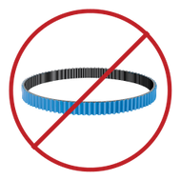
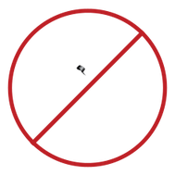

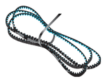







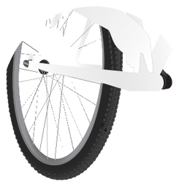
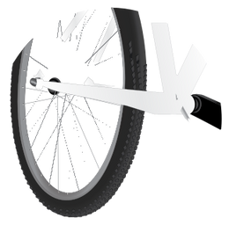
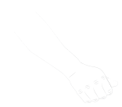
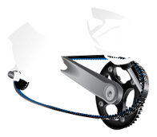



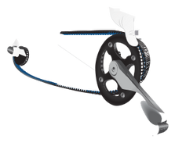






4
HANDLING THE BELT
DO NOT ROLL ON
DO NOT PRY ON

Slide 5
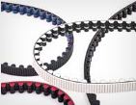
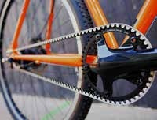
5
LESS NOISE. LESS MAINTENANCE. A WHOLE LOT MORE FUN.
We are thrilled and honored that you have chosen a bicycle equipped with Gates Carbon Drive™. We hope you enjoy the difference Clean, Quiet, Light and Strong will mean for your ride. This manual explains the performance benefits of the system, information about proper care and tensioning, as well as warranty instructions.
3 4 6 7 8
General Safety Handling the Belt What is Gates Carbon Drive? Why Gates Carbon Drive? Care for your Carbon Drive System
10 Proper Tension is Key 13 Proper Alignment 14 Replace When Worn 16 Rear Wheel Removal + Installation 18 Who is Gates? 19 Warranty

Slide 6
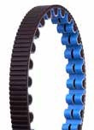
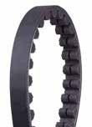
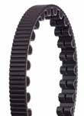
6
WHAT IS GATES CARBON DRIVE?
The technology behind Gates Carbon Drive System is rooted in high horsepower motorcycles and dragsters. Now, this high performance technology has been perfected for a wide variety of bicycles. At the core of the drive is the Carbon Drive belt. Custom made, this 11mm pitch, carbon-fiber belt is a strong and efficient replacement to a traditional bike chain. The drive is completed with our innovative sprocket designs and your choice of internally-geared or single-speed hub. The patented Gates Carbon Drive System gives you a longer-lasting, lower- maintenance drive, and most importantly, an unbelievably awesome ride.
CDX
CENTERTRACK BELT
CDN
CENTERTRACK BELT

Slide 7
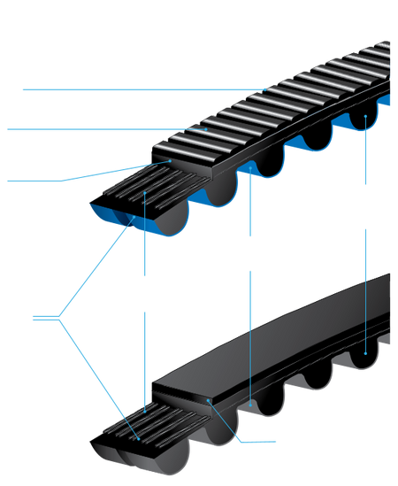
WHY GATES CARBON DRIVE?
7
CLEAN. LOW MAINTENANCE.
LIGHT.
Gates Carbon Drive weighs less than a chain drive. Lighter weight means higher performance.
STRONG.
The instant engagement and smooth feel is unlike anything you’ve experienced before. You’ve got to ride it to believe it.
No lube required = no grease stains. It sheds dirt and grime and cleaning with water is easy. Just get on it and ride.
QUIET.
No chain = no chain clatter. It’s spooky quiet.
CDX + CDN
BELT CONSTRUCTION
RIBBED BACK BELT
POLYURETHANE CONS T RUC T ION
HIGH MODULUS ENGINEERED POLYMER
BICYCLE-OPTIMIZED CURVILINEAR TOOTH
PROFILE
NYLON TOOTH FACING WITH COLORED JACKET
CARBON FIBER TENSILE CORDS
CENTERTRACK™ BELT
HIGH MODULUS ENGINEERED POLYMER

Slide 8
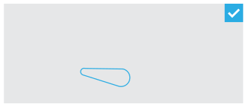
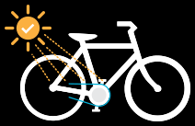


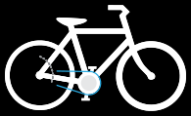
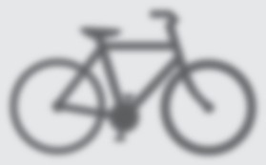



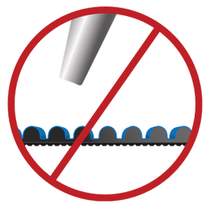

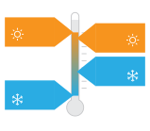
8
CARE FOR YOUR CARBON DRIVE
CDX/CDC 1 8 5˚F 85˚C
CDN 1 4 0˚F 60˚C
CDN
-4˚F
-20˚C
CDX/CDC - 6 5˚F - 5 3˚C

Slide 9
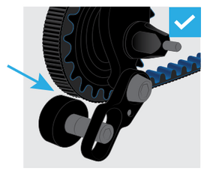
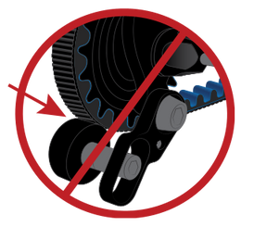
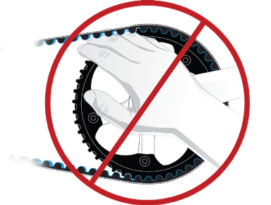
= APPROVED
= NO
9
Snubber not standard on all models.
DANGER
Use Caution. Although clean of grease, belt drives can still catch pants, skirts or loose clothing. Installation of a belt guard is recommended.

Slide 10
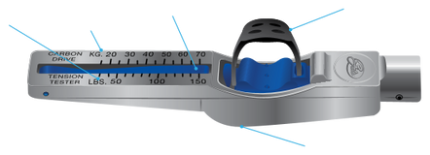
10
PROPER TENSION IS KEY
Proper belt tension is essential for optimum operation of the Gates Carbon Drive System. Lack of belt tension can lead to tooth jump or “skipping”, when the teeth of the belt slide over the teeth of the rear sprocket. Too much tension can damage the bearings within the rear hub, can cause the system to drag, and can increase the wear of your drive system.
Tensioning procedures vary depending on the bike. Common types of
tensioning systems include sliding or pivoting dropouts and eccentric bottom brackets. Note – Correct alignment of the belt has to be maintained as you adjust tension.
There are 3 common methods for measuring tension on your Carbon Drive
system: the Gates Krikit Gauge, the Eco Tension Tester, and the Gates Carbon Drive Mobile Apps. For each of these, the tension may vary a little along the belt, so you should repeat this procedure several times. Rotate the cranks a quarter turn after each measurement and measure again.
The tools only measure tension, they do not specify a needed tension.
Refer to the chart below for the correct tension range recommendation for your Gates Carbon Drive setup.
TENSION RECOMMENDATIONS
SMOOTH + STEADY PEDALING STYLE
PUNCHY + ROUGH PEDALING STYLE
Mountain* and SS Urban Internally Geared Hub Tandem
45-60 Hz (35-45 lbs)
60-75 Hz (45-53 lbs)
35-50 Hz (28-40 lbs) 60-65 Hz (45-48 lbs)
These tension recommendations are a good starting point, which may need to be adjusted
higher or lower based on the rider size, gear ratio, and power placed on the pedals.
* The CDN System is not approved for use on mountain bikes, mid-drive eBikes or gear boxes,
fixed gear bikes, or high mileage trekking/touring bikes.
GATES KRIKIT GAUGE (NORTH AMERICA)
LBS SCALE
POUNDS
KG SCALE
K ILOGR AMS
INDICATOR ARM
FINGER STRAP
GAUGE LIP

Slide 11
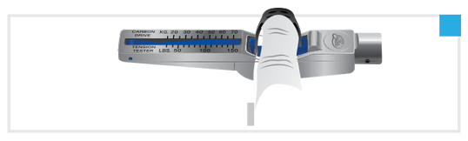




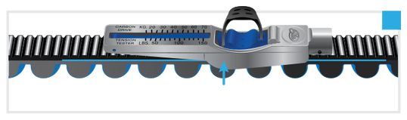

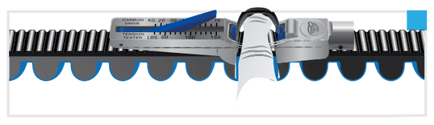


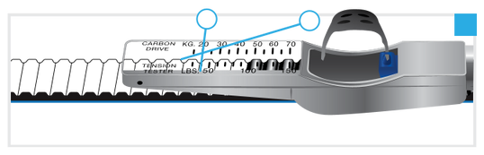

















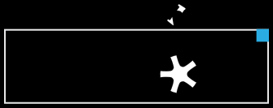

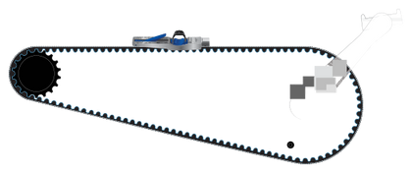






CHECKING BELT TENSION:
GATES KRIKIT GAUGE (NORTH AMERICA)
11
1
Verify Indicator Arm is positioned completely down. Place index finger in the rubber Finger Strap, on top of the Click Pad, as shown.
2
Place Krikit Gauge on top of the belt and position the gauge in the middle of the total belt span, making sure the Gauge Lip sits flush against the belt.
3
Press down on tester Click Pad until it clicks. It is critical to use only one finger on the gauge.
4
A
and
B.
Measurement point is the intersection of lines The gauge tension reading above is: 20 KG
5
Rotate crank one-quarter turn and repeat previous steps 1 to 4. Repeat
rotation and measurement
no less than 3 times.

Slide 12
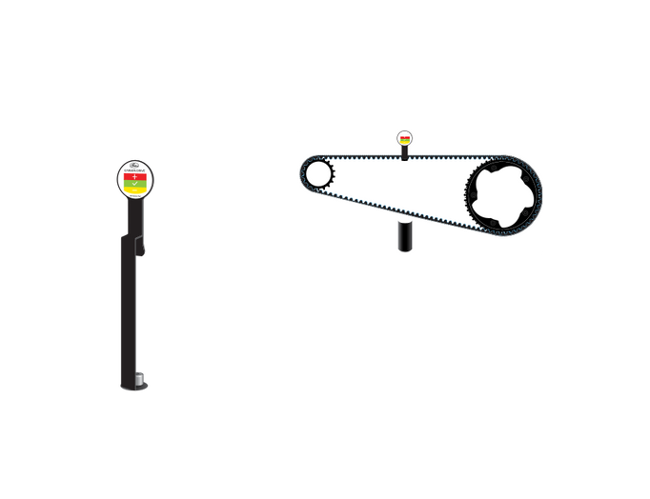


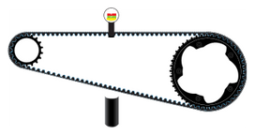
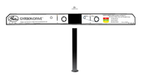

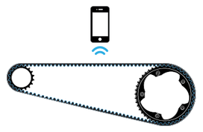
12
PROPER TENSION
ECO TENSION TESTER
1
Hang the main tower on the belt.
RULER
TENSION INDICATOR
MAIN TOWER
H ANGER
2
Put the ruler on the two sprockets. Check the tension:
Red
Increase the tension
Green Tension is good
Yellow Decrease the tension
MEASURING WEIGHT
GATES CARBON DRIVE MOBILE APPS
Belt tension can also be measured with the Gates Carbon Drive Mobile Apps, offered on both iPhone and Android. These apps can measure the belt tension in the form of natural frequency (Hz) of the belt span. Operating instructions are provided within each app. Basic operating instructions are to open the app, make sure the microphone is on, and then hold the phone over the top of the belt in the middle of the span – be sure the phone’s microphone is facing the belt. Pluck the belt so that it vibrates similar to a guitar string. The app will convert the sound into the primary frequency of the belt. Rotate the crank to move the belt about a ¼ turn, and repeat the measurement process. Do this for at least one full revolution of the belt. Compare your belt’s frequency to the chart (pg 10) to see if you need to adjust the tension. The Carbon Drive app works best in a quiet environment.

Slide 13
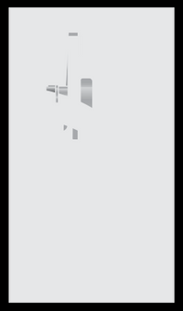

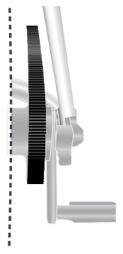
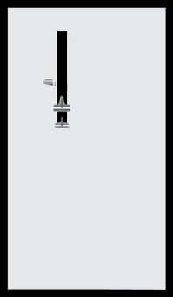
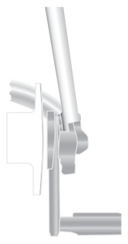






PROPER ALIGNMENT
13
Alignment is critical, depending on the particular bike and setup, spacers may be used to ensure proper alignment. Sprockets that are out of alignment can cause noise, wear, or belt walk-off. Belt alignment refers to the parallel (side to side) and angular (toe in – toe out) alignment of the belt between the front and rear sprocket positions. Proper alignment is critical in order to maintain proper system performance. For detailed information and schematics regarding alignment, please see our Technical Manual, located at:
www.gatescarbondrive.com/tech/resources
PROPER ALIGNMENT
SPROCKETS ARE NOT ALIGNED

Slide 14

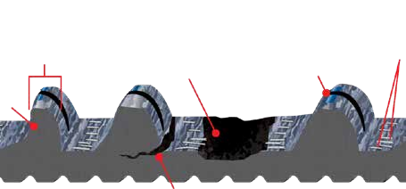
14
REPLACE WHEN WORN
Gates Carbon Drive™ Belts and Sprockets are extremely durable and built to offer a long life, but they do wear and tear over time. Periodically, carefully inspect your belt and sprockets for signs of deterioration:
This belt is in excellent condition.
Loss of blue color does NOT indicate wear.
Carbon Cords are exposed
Not Symmetrical
Missing
Fabric worn with exposed polymer body
Tooth
Shark Tooth
Cracks
Replace your belt when it shows these signs of wear and tear. WARNING: Using a worn or damaged Carbon Drive belt or failing to properly inspect the Carbon Drive belt before each usage can result in property damage and serious bodily injury, including death.

Slide 15
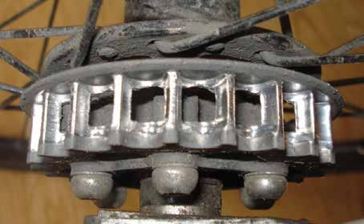




















REPLACE WHEN WORN
15
Worn MudPort Sprocket Teeth
Replace your MudPort sprockets when the teeth become worn as shown in the illustration above.
This CenterTrack Sprocket
is in excellent condition.
Replace your CenterTrack sprockets when the teeth become worn as shown in the illustration above.

Slide 16
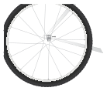



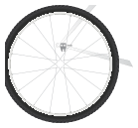



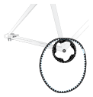
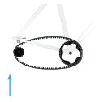
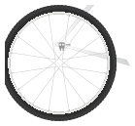

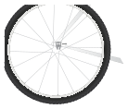







16
REAR WHEEL REMOVAL & INSTALLATION
See bike manufacturer for additional wheel removal details.
1
2
3
4
5
6

Slide 17















REAR WHEEL REMOVAL & INSTALLATION
17
See bike manufacturer for additional wheel removal details.
DO NOT ROLL ON
DO NOT PRY ON

Slide 18

18
WHO IS GATES?

Slide 19
GATES CARBON DRIVE
19
CARBON DRIVE™ SYSTEMS LIMITED PRODUCT WARRANTY
We make this quality commitment: at the time of sale to our customers, Gates Carbon Drive Systems Products (belts, sprockets, and accessories used in the bicycle market) will be free from defects in materials and workmanship. Products will be warranted only to the original retail purchaser for a period of two years from the original date of purchase. If we determine a product does not comply, we will, at our option, replace or repair the product. This is your exclusive remedy. Color fade and color difference is not warranted.
Damage to the product due to abuse, improper use, inadequate maintenance,
or failure to follow Gates Carbon Drive Systems’ published recommendations
for installation, use and service will automatically void this warranty. Before using
this product, please read the handling and installation instructions carefully
(a copy of which is located at www.gatescarbondrive.com/OwnersManual).
For warranty service, please contact the retailer from whom the product
was purchased.
THERE IS NO OTHER EXPRESS WARRANTY. FURTHER, WE DISCLAIM ALL IMPLIED
WARRANTIES, INCLUDING BUT NOT LIMITED TO THE WARRANTIES OF FITNESS
FOR A PARTICULAR PURPOSE AND MERCHANTABILITY.
Some states do not allow the exclusion or limitation of damages, and some states
do not allow limitations on how long a warranty lasts, so the above limitation and
exclusion may not apply to you. This warranty gives you specific legal rights, and
you may also have other rights which vary from state to state.
Return Policy: Gates Carbon Drive Systems Belts cannot be returned or exchanged.
For more information in Europe contact:
Gates Carbon Drive – Germany Bicycle Lab Mühlhausen Germany +49 (0) 3601 888 6484 info@Car bonDr ive.net
For more information in North and South America contact:
Gates Carbon Drive Denver, CO USA 303-744-4755 CarbonDrive@gates.com

Slide 20

GATES CORPORATION
CarbonDrive@gates.com www.GatesCarbonDrive.com
©2013-2020 Gates Corporation
17571–OM 2020/05
98-1846
Visit www.GatesCarbonDrive.com/OwnersManual for updates and other languages.
The color “carbon blue” is a trademark of Gates Corporation.

